Slide 1
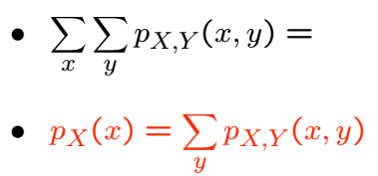
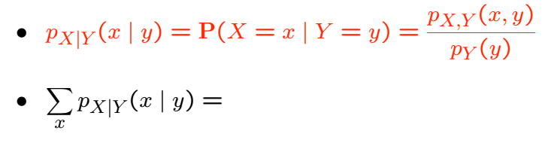
Conditional PMF of a RV Given Another
• Recall:
• Conditional PMF of a RV given another: A version of Bayes’ Rule:

Slide 2
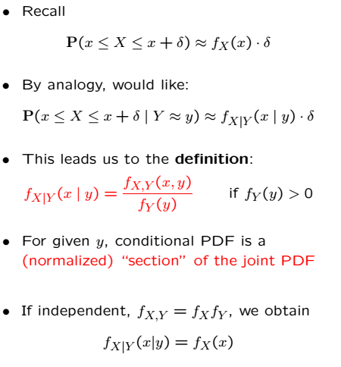
Conditional PDF of a RV Given Another

Slide 3
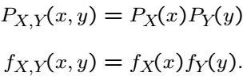


Independent RVs
Two RVs are independent if the joint dist. is the product of marginals
Another definition: Conditioning makes no difference

Slide 4
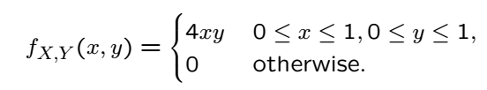
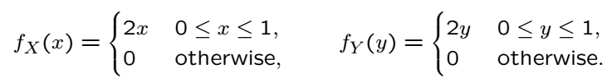
Example
YES!

Slide 6
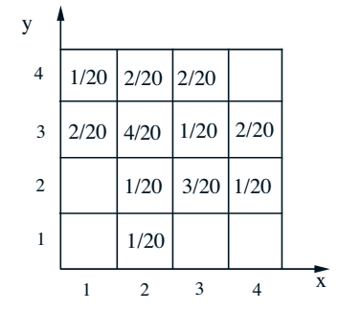
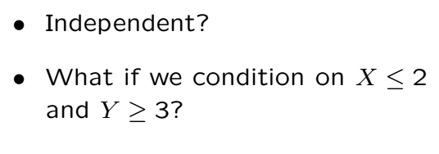
Example

Slide 7
Acknowledgements and Citations
Parts of these slides are adapted from the following resources:
Power Point Lecture Slides for the Textbook http://bcs.wiley.com/hebcs/Books?action=index&bcsId=8676&itemId=1118324560
John Tsitsiklis. 6.041 Probabilistic Systems Analysis and Applied Probability, Fall 2010. (Massachusetts Institute of Technology: MIT OpenCourseWare),http://ocw.mit.edu (Accessed 13 Apr, 2015). License: Creative Commons BY-NC-SA

